Slide 1
System Design & Analysis
Lecture 06

Slide 2
History of Object Model
The early computer languages that were used for mathematical and scientific operations
Freed the programmer from complexities of assembly language
Growth in size & complexity to evolution in languages to accommodate new features
E.g. automation for business application
Slowly, language evolved even more
Software moved closer to problem domain and further away from the machine

Slide 3
Object Model
The newer languages that were created they used classes and objects as building blocks instead of such programs and algorithms
These languages build upon object model.
The object model is based upon three important concepts
object oriented analysis
object oriented Design
object oriented Programming

Slide 4
Object Oriented Analysis
Object Oriented analysis is a method of analysis that examines the requirements from the perspective of the classes and objects found in the vocabulary of the problem domain.
Grady Booch
The is the first step for developing an object-oriented system
Investigation of problem and requirements rather solution
Focus at the behavior of the system independent of its domain
Examines the real-world environment in which the system will operate
Includes people and things that will interact to produce some results
Analyzed in a basic abstract forms, in multiple iterations
These abstractions later become classes in the problem domain

Slide 5
Example - Library
Member requests a book from the library
Librarian will search for the book
If found, the book is issued
The dataset is updates with the issued book
If unavailable, the request is placed in a queue
If not found, an order may be placed for the book

Slide 6
Analysis
Highest level analysis or abstraction
This will continue until the objects are uniquely identified
The objects are refined as abstractions with the key characteristics
Emphasis on investigation rather than the solution

Slide 7
Object Oriented Design
object oriented design is a method of design encompassing the process of object oriented decomposition and a notation for depicting both logical and physical as well as starting and dynamic models of a system under design object oriented design
Grady Booch
Focus on OO decomposition
Used different notation to express different models of the system
High level concepts of analysis are mapped onto classes
Hierarchical association among the classes are designed
Results in detail description that specifies how the system is to be built using different technologies

Slide 8
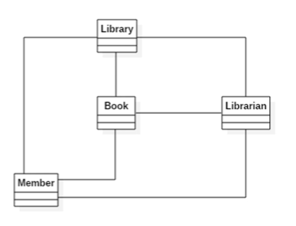
Example - Library

Slide 9
Object Oriented Programming
It is a method of implementation in which programs are organized as cooperate to collection of objects, each of which represents an instance of some class, and whose glosses are all members of a hierarchy of classes united via inheritance relationships
Uses objects as a fundamental blocks
Classes & Objects are related through relationships
Requires programming language that supports
Object as abstraction
Classes
Generalization of classes
languages like Java or C++ C sharp can be used to write objects or into programs.

Slide 10
Summary
The object model builds upon three important concepts
object oriented analysis, design and programming.
Analysis part focuses on the problem
Design is about OO decomposition and expression of the design using some notations
Programming is the implementation using OO languaes

Slide 11
Object Oriented Analysis- Use Case

Slide 12
Use case
OO analysis focuses on the problem and requirements
Focus in what the system supposed to do
Implementation details are mostly ignores
An analysis model is created
Done through user stories or use cases
Involves key abstraction fro the problem domain
Constraints of technologies are ignored

Slide 13
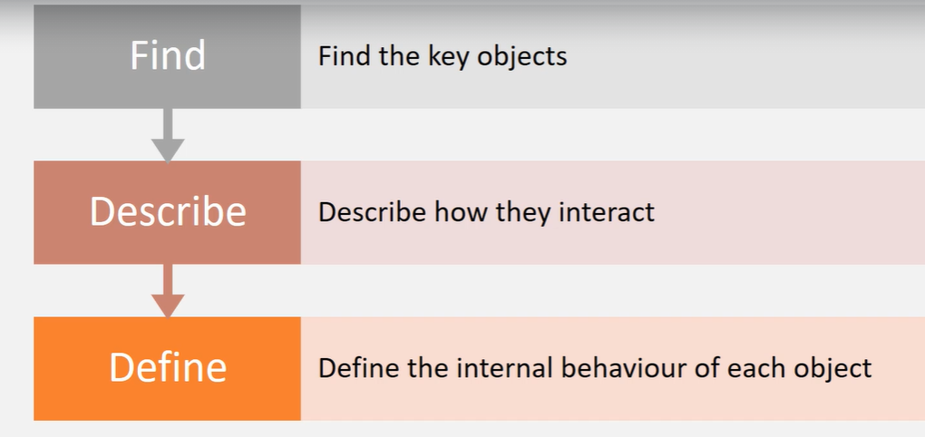
OO Analysis
In OO analysis we performed OO decomposition
Steps

Slide 14
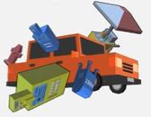
Example: Car game(Reckless Driver)
Object: keep driving as long as you can & earn money by smashing objects. Spend money on powerips
Smash into traffics, side objects (hydrant, phone booth, etc.)
Each hit will damage the player car and reduce its health
Repair through health pickups
Amount if damage caused is accumulated by the player
Smash anything, except trees & police cars (causes instant player death)
Powerups are available
heavy armour: protects players car from damage
Bomb: destroys objects in the path of the player car

Slide 15
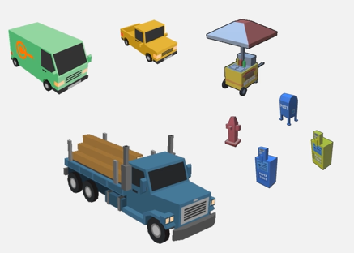
Key Objects
Player car
Traffic cars
Fire hydrant
Phone booth
Newpaper box
Bus stand bench
Hotdog vart
Tree
etc

Slide 16
Example Gameplay
The player car smashed into traffic car
Show sparks at point of contact
Play crash audio
Apply damage to player car & reduce health
Computer damage caused to traffic car
Accumulate damage as cash

Slide 17
Use Case
Defines a model of a system behavior
Uses natural language
Designers and programmers use a common reference
Decomposes layer system specification into small manageable parts
Smaller parts are easily described, hence easily implemented
Models functional behaviors of the system

Slide 18
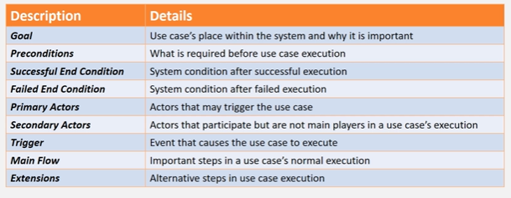
Use case Description

Slide 19
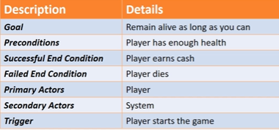
Gameplay

Slide 20
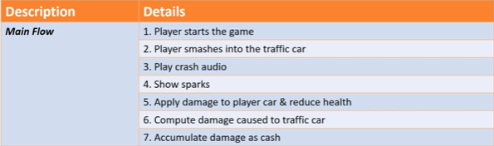
Main Flow

Slide 21
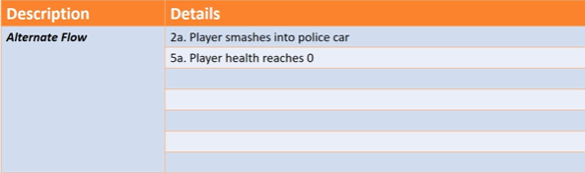
Alternate Flow

Slide 22

Use Case Diagram
Describes discrete unit of behavior that has a clearly defined scope
Illustrates what should be done to achieve the goal of the use case
This ultimately maps into program code
Shown as an oval shape with the description of the behavior

Slide 23

Actor
External entity that interacts with the system
Could be a person, system or some external entity
Maybe defined outside the system
Acts as a black box and cannot be changed
Appears as a stick figure

Slide 24
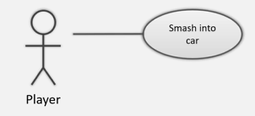
Communication line
Connects an actor and a use case
Indicated participation of an actor
Appears as a line between an actor & the use case

Slide 25
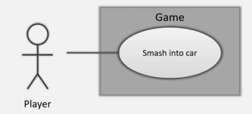
System Boundaries
Indicates separation between actors and use cases (internal to the system)
Marked by a bounded box around the use cases

Slide 26
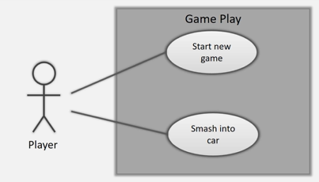
Example

Slide 27
Modelling Tools
Enterprise Architect
Microsoft Visio
Star UML
Papyrus
Visual Paradigm

